Slide 1
Burning Choices Course Project for CSCI 352 Hunter, Ethan, and Jamel

Slide 2
Background
What is this project?
A choice based video game that encompasses different endings.
Why did we do this project?
We all love video games, so why not just make one by ourselves.
What you need to know!
We used a WPF Application for this project and slightly bit off more than we could chew.

Slide 3
Approach
How did we do it?
We started with a basic WPF application.
Created Multiple windows and tied them together.
Used Photoshop CC 2015 for all design.
Special Libraries/Drivers?
Used the Image Class for programming.
Design Patterns that we used!
We used the abstract factory design pattern.
We also used the observer pattern.

Slide 4
Class Diagrams
Three man group
Hunter was the lead designer
Ethan was the lead programmer
Jamel was the lead project manager

Slide 5
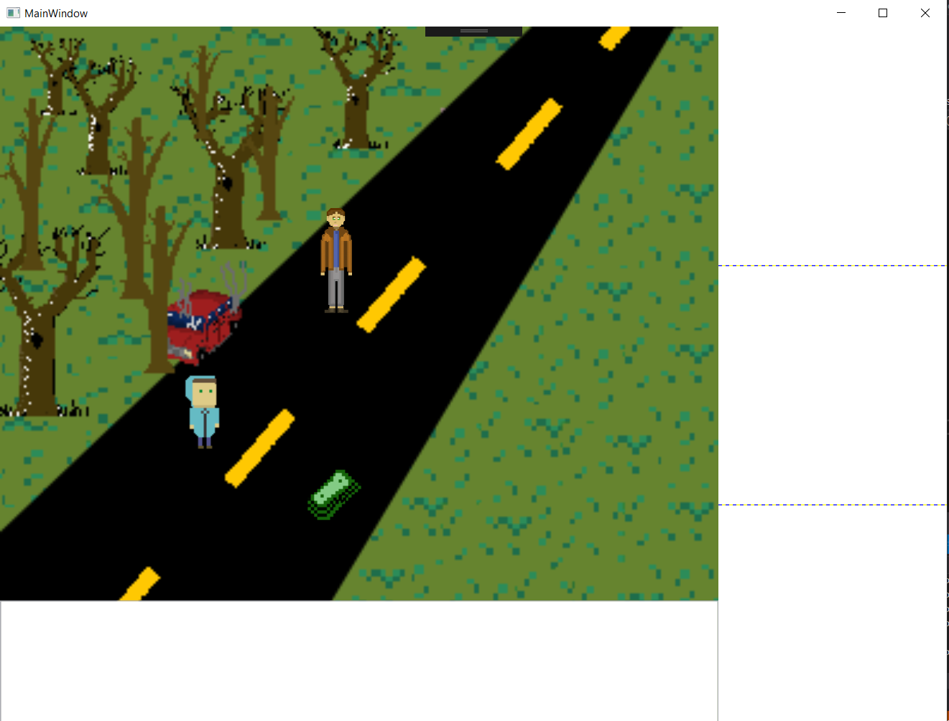
Demo!
To begin the game, we simply just load the project up on Visual Studios and hit the play button!

Slide 6
Future Work
We plan to get all features implemented.
Better designs!
Able to work on all operating systems.

Slide 7
Questions?
Emails
hunlhais@ut.utm.edu
ethcseib@ut.utm.edu
jamnwarr@ut.utm.edu
Our Repo
https://github.com/ethcseib/CSCI352-EOC-project

